Slide 1

Chapter 16
Search Engine Optimization

Slide 2
Learning Objectives
How to monitor your site’s traffic
What are the pros and cons of keyword advertising within a search engine to drive traffic
How search engines use robots to index site content
What is the role of metadata keywords within a webpage
How to control well-behaved search engine robots
How to create an XML-based sitemap
How to place advertisements in your site

Slide 3
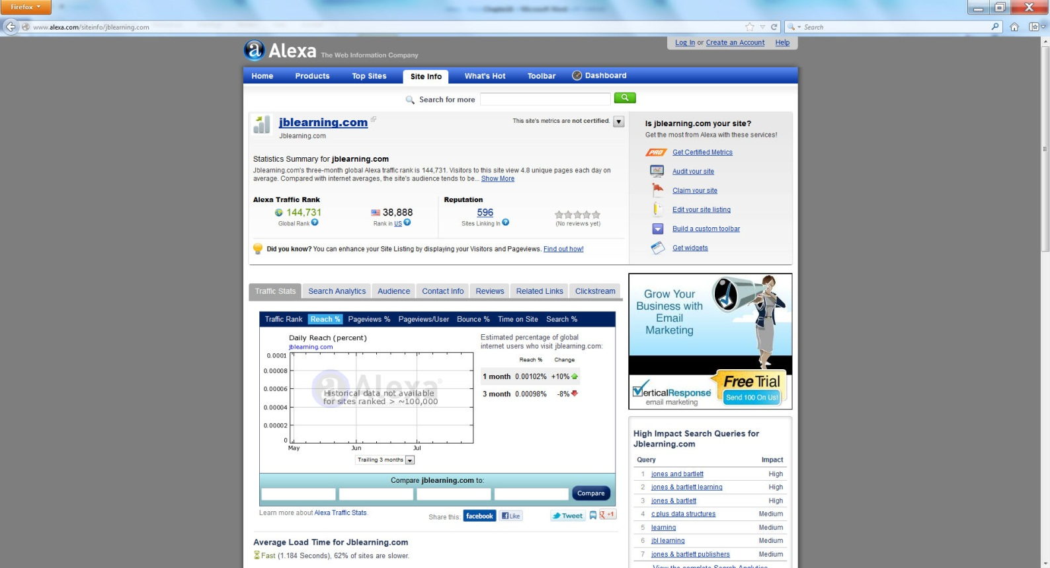
Using alexa (and others) to track traffic

Slide 4
Option 1: pay to play
Paying for keyword placement within a search engine’s results can be an effective way for companies to drive traffic to their site. Normally, it does not cost the company anything to appear within the search result’s list. Instead, the companies will pay the search engine a fee each time a user clicks on their link—a process called pay per click (PPC).
Unfortunately, depending on the keywords you desire, the cost per click (CPC) can become expensive—ranging from a few cents to tens-of-dollars per click! To create a keyword-based advertising campaign, you normally select you keywords and a maximum bid amount for each. In addition, you tell the search engine how much you are willing to spend each day.

Slide 5
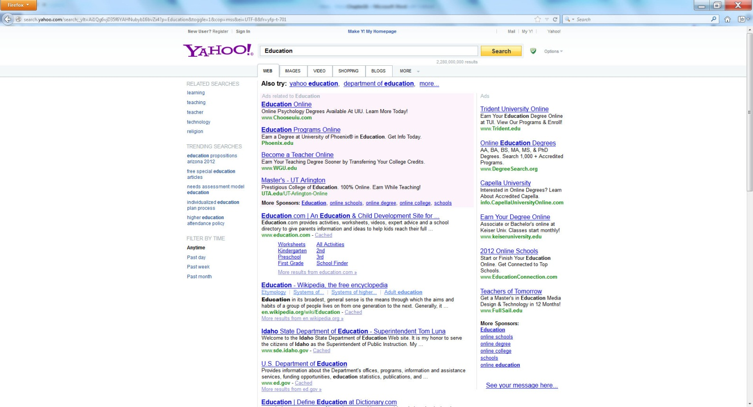
Paying for placement

Slide 6
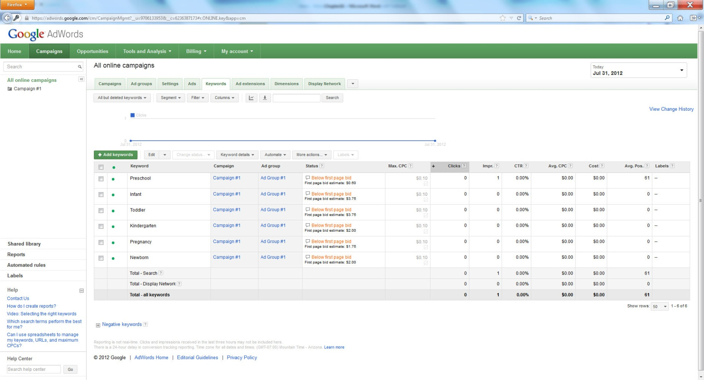
Sample bids

Slide 7
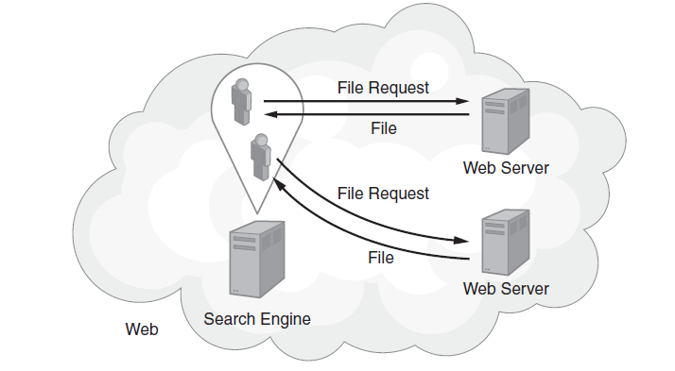
Option 2: Optimize Your Page Keywords for Robots

Slide 8
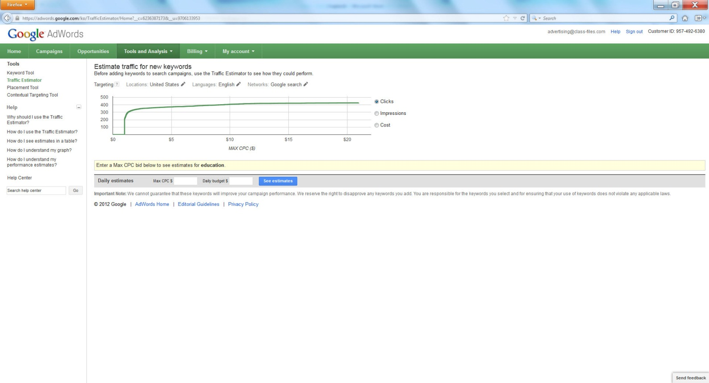
Using Google’s Keyword Tools

Slide 9
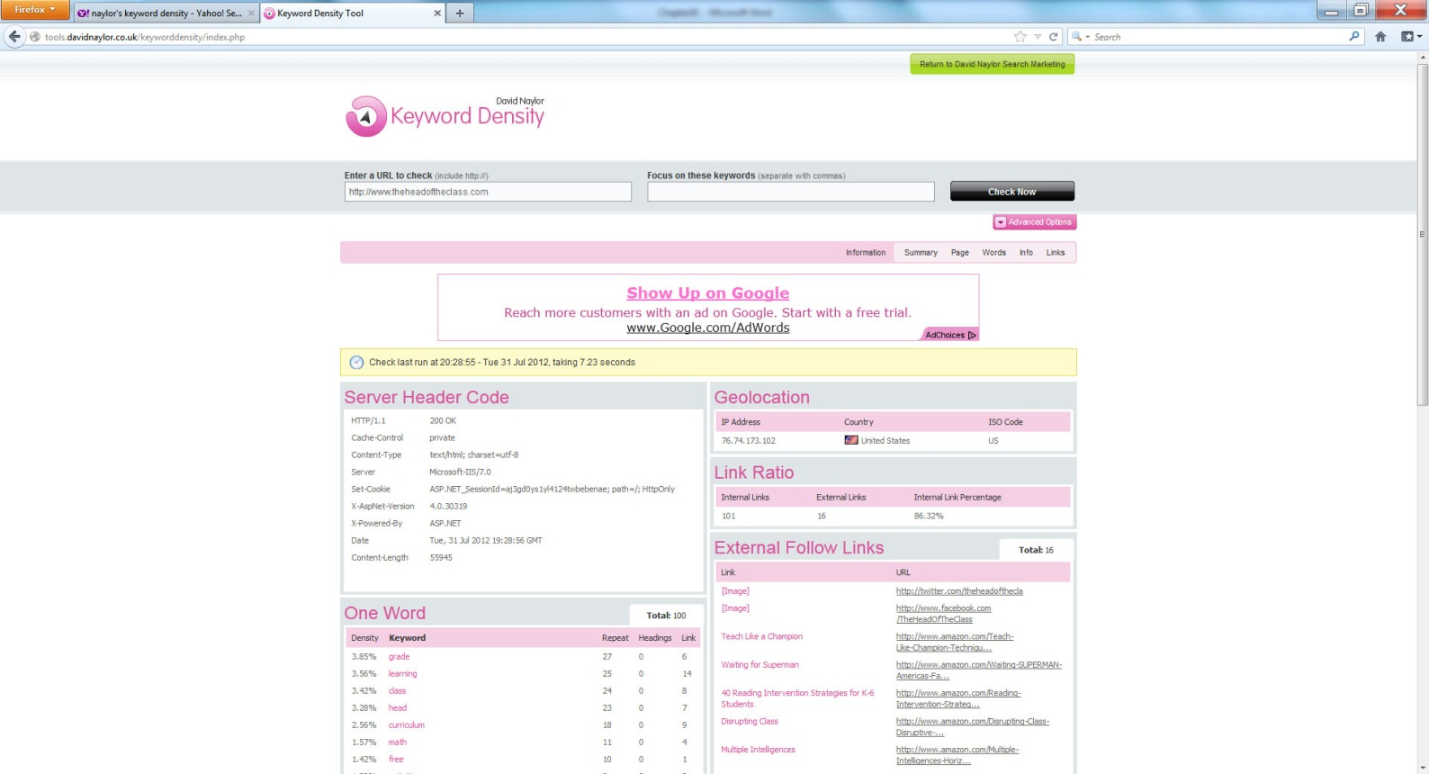
Examining Your Site’s Keyword Density

Slide 10
Option 3: Provide a Meaning Page Title and <img> Tag alt= Attributes
After you place meaningful <meta> tags within your webpages, you should then use a <title> tag to assign a meaningful title to your page. Then, for each <img> tag, make sure you provide descriptive text within the corresponding alt attribute. As robots examine your page contents, they may use these tags to help determine the content the page presents.

Slide 11
Option 4: Build Credibility Through Incoming Links
One of the ways to increase your site’s credibility is to grow the number of sites that link into it. If you examine the Alexa screen previously shown, you will see that Alexa tracks a “Reputation,” which corresponds to the number of sites that link in.
To increase the number of sites that link to yours, consider exchanging advertisements with other sites in a process in which you both display each other’s ad at no cost.
You might also ask related bloggers to include links to your site or possibly to exchange ads.
Lastly, you should leverage social media sites such as Facebook, Digg, Pintrest, and others to post links to your pages.

Slide 12
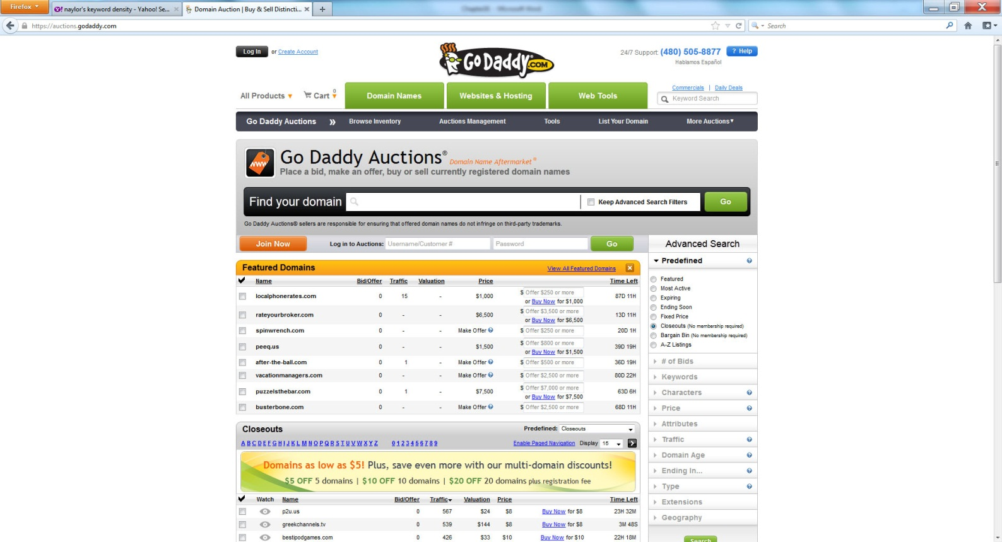
Option 5: Select a Good Domain Name

Slide 13
Option 6: Creating a robots.txt File
A robot is a special program search engines run that scours your webpage content in search of topics it can index. Developers consider robots that perform such search engine indexing as “good” robots. Unfortunately, there are other types of “bad” robots that scour webpages in pursuit of e-mail addresses and other content that can later be used by spammers.
The bottom line with respect to robots, both good and bad robots, is that there really is no way to prevent them from examining your publically accessible Web content. That said, before a well-behaved robot will search your site, the robot will normally look for a robots.txt file on your Web server that you can use to control which directories the robot searches and indexes. The bad-behaved robots, however, simply ignore your robots.txt file.

Slide 14
Controlling robots
The following robots.txt file directs robots not to browse any directories:
User-agent: * Disallow: /
In this case, the asterisk following the User-agent entry is a wildcard that states the settings that follow are for all browsers. The Disallow entry specifies the site’s root, which essentially disables all child directories, too.
Normally, you will want robots to examine your content so they can index it within a search engine. You may, however, have one or more directories that have content you don’t want the robots to examine. The following robots.txt file, for example, directs robots to ignore the images and videos directories:
User-agent: * Disallow: /images Disallow: /videos

Slide 15
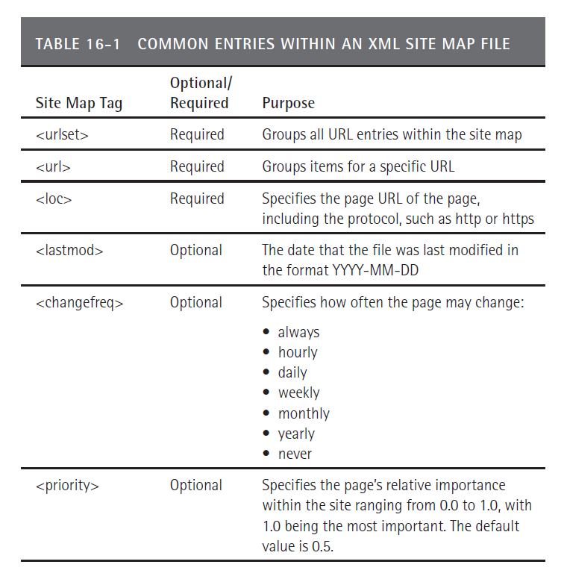
Option 7: Creating a Site Map

Slide 16
Sample site map
<?xml version="1.0" encoding="UTF-8"?> <urlsetxmlns="http://www.sitemaps.org/schemas/sitemap/0.9"> <url> <loc>http://www.somesite.com/</loc> <lastmod>2012-07-04</lastmod> <changefreq>daily</changefreq> <priority>0.7</priority> </url> <url> <loc>http://www.somesite.com/fliers/</loc> <changefreq>weekly</changefreq> </url> <url> <loc>http://www.somesite.com/photos/</loc> <lastmod>2012-12-25</lastmod> <changefreq>weekly</changefreq> </url> <url> <loc>http://www.somesite.com/audios/</loc> </url> </urlset>

Slide 17
Option 8: Specifying Canonicalization
Depending on the software you use to create your site or the subtle differences in page content that you use for different user types, there may be times when two or more pages are essentially the same. Unfortunately, when robots search your page content, they may index each of the similar pages, which may later confuse search engine users.
Canonicalization is a term used to describe the process of converting data into one standard form. With respect to webpages, canonicalization means having one standard page. If your site has similar pages, and you only want search engines to index a specific page, place a <link> tag with the rel=“canonical” attribute at the top of similar pages that specify the page you want the robots to index, as shown here:
<!DOCTYPE html> <html> <head> <link rel="canonical" href="http://www.somesite.com/primaryLink.html> </head> <body> Page Content Here </body> </html>
In this case, the <link> tag specifies that the primaryLink.html file is the one the search engine should index.

Slide 18
Option 9: Using 301 Redirects
As the contents of your website evolve, there may be times when you move or rename one or more files. Unfortunately, a search engine may have previously indexed the file, which means users will encounter errors when they click on the search engine link. To avoid such errors, redirect references to the old page to a new page using a process called a 301 redirect. The 301 is an HTTP status value that tells the requesting browser that the page has moved.
Depending on the Web server you are using, the steps you must perform to redirect one page to another will differ. If your Web server supports PHP, you can use the following code snippet to redirect one page to another:
<? Header( "HTTP/1.1 301 Moved Permanently" ); Header( "Location: http://www.somesite.com/newlocation/" ); ?>

Slide 19
Real world: CPM CPC
Advertisers normally pay for ads in one of two ways. The first is called “cost per impression” and is based on the display of the ad. Normally advertisers will pay for such “impressions” on a cost-per-thousand-impressions basis, known as CPM. Rates for CPM-based ads can range from less than a dollar to over $20 dollars depending on the product and demographic audience. Assuming a $5 CPM and daily traffic of 10,000 users, the ad revenue would become:
Revenue = (views)(rate)/1000
= (10,000)($5)/1000
= $50 a day
As you might guess, for an advertiser, simply displaying ads within a page already filled with other ads may not be the most cost-effective way to advertise. As an alternative, many advertisers will place ads on a cost-per-click basis, for which they don’t pay for the display of the ad, but they pay only when a user clicks on the ad. Assuming the advertiser pays $0.30 per click and the site has 1,000 clicks a day, the revenue would become:
Revenue = (clicks)(rate)
= (1,000)($0.30)
= $30 a day

Slide 20
summary
Across the Web, users often find a site’s content through a related search engine query.
Search engine optimization is the process Web developers perform to increase a site’s ranking within a search engine’s query results.
This chapter examines techniques developers should perform to optimize their site rankings.
In addition, the chapter examines ways developers can monitor their site traffic in order to better understand the effectiveness of their SEO operations.
Finally, the chapter looks at ways a developer might advertise or integrate advertisements into a webpage.

